Slide 1
Creating Classes from Other Classes
Appendix D
© 2015 Pearson Education, Inc., Hoboken, NJ. All rights reserved

Slide 2
Composition
A class uses composition when it has a data field that is an instance of another class
Composition is a “has a” relationship
Consider a class of students, each has
  A name, an identification number.
Thus, class Student contains two objects as data fields:
  An instance of the class Name
  An instance of the class String:
© 2015 Pearson Education, Inc., Upper Saddle River, NJ. All rights reserved

Slide 3
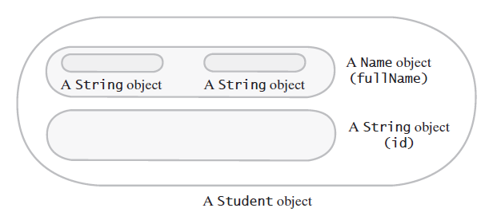
Composition
FIGURE D-1 A Student object is composed of other objects
© 2015 Pearson Education, Inc., Upper Saddle River, NJ. All rights reserved

Slide 4
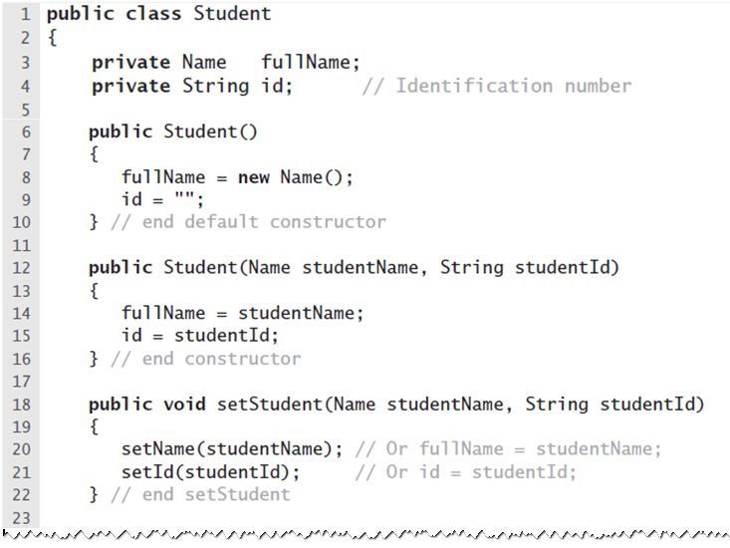
Composition
LISTING D-1 The class Student
© 2015 Pearson Education, Inc., Upper Saddle River, NJ. All rights reserved

Slide 5
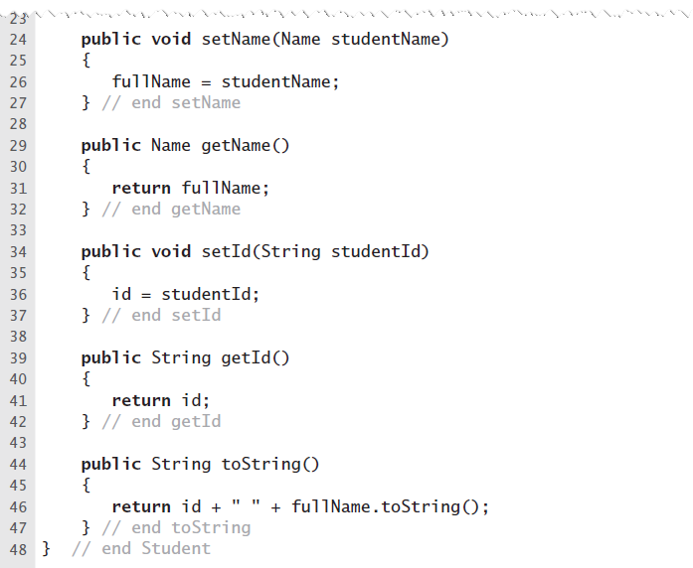
Composition
LISTING D-1 The class Student
© 2015 Pearson Education, Inc., Upper Saddle River, NJ. All rights reserved

Slide 6
Adapters
Consider reuse of a class where …
  Names of its methods do not suit your application
  You want to simplify some methods
  Or eliminate others
An adapter class
  Uses composition to write a new class that has an instance of your existing class as a data field
  Defines the methods that you want
© 2015 Pearson Education, Inc., Upper Saddle River, NJ. All rights reserved

Slide 7
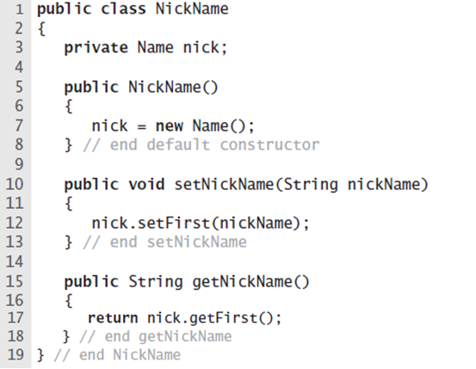
Adapters
LISTING D-2 The class NickName
© 2015 Pearson Education, Inc., Upper Saddle River, NJ. All rights reserved

Slide 8
Inheritance
Allows you to define general class
  Then later to define more specialized classes
  Add to or revise the details of the older, more general class definition
Inheritance is an “is a” relationship
Example: general class of vehicles
  Subclasses automobile, wagon, and boat, etc.
© 2015 Pearson Education, Inc., Upper Saddle River, NJ. All rights reserved

Slide 9
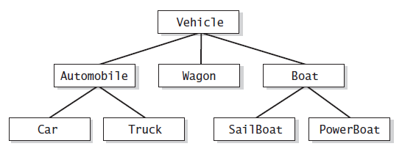
Inheritance
FIGURE D-2 A hierarchy of classes
© 2015 Pearson Education, Inc., Upper Saddle River, NJ. All rights reserved

Slide 10
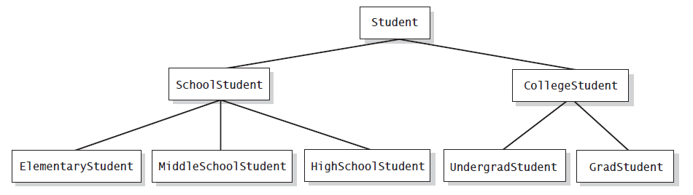
Inheritance
FIGURE D-3 A hierarchy of student classes
© 2015 Pearson Education, Inc., Upper Saddle River, NJ. All rights reserved`

Slide 11
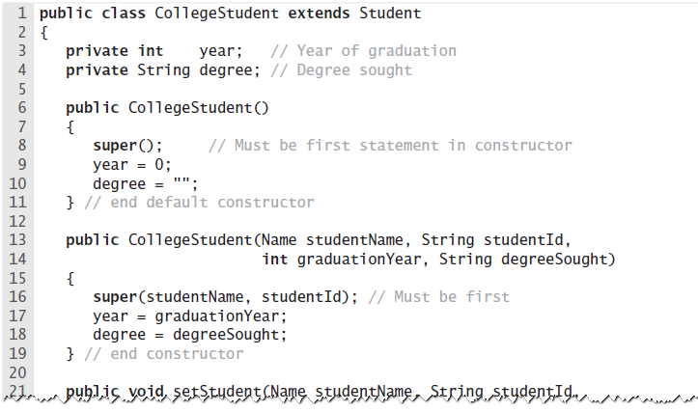
Inheritance
LISTING D-3 The class CollegeStudent
© 2015 Pearson Education, Inc., Upper Saddle River, NJ. All rights reserved`

Slide 12
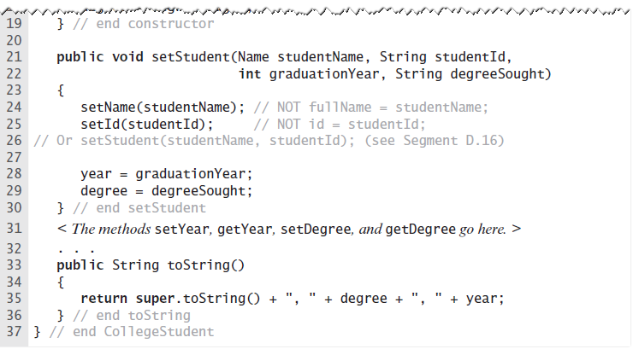
Inheritance
LISTING D-3 The class CollegeStudent
© 2015 Pearson Education, Inc., Upper Saddle River, NJ. All rights reserved

Slide 13
Invoking Constructors from
Within Constructors
Constructors typically initialize a class’s data fields
To call constructor of superclass explicitly.
  Use super( ) within definition of a constructor of a subclass
If you omit super( )
  Constructor of subclass automatically calls default constructor of superclass.
© 2015 Pearson Education, Inc., Upper Saddle River, NJ. All rights reserved

Slide 14

Invoking Constructors from
Within Constructors
Also possible to use this to invoke constructor of superclass
© 2015 Pearson Education, Inc., Upper Saddle River, NJ. All rights reserved

Slide 15
Private Fields and
Methods of the Superclass
Only a method in the class Student can access fullName and id directly by name from within its definition.
Although the class CollegeStudent inherits these data fields,
  None of its methods can access them by name
Instead it must use some public mutator method such as setId.
© 2015 Pearson Education, Inc., Upper Saddle River, NJ. All rights reserved

Slide 16
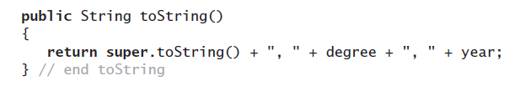
Overriding and
Overloading Methods
Possible to new method invoke the inherited method
  Need to distinguish between the method for subclass and method from superclass
© 2015 Pearson Education, Inc., Upper Saddle River, NJ. All rights reserved

Slide 17
Overriding and
Overloading Methods
When a subclass defines a method with
  the same name
  the same number and types of parameters
  and the same return type as a method in the superclass …
Then definition in the subclass is said to override the definition in the superclass.
You can use super in a subclass to call an overridden method of the superclass.
© 2015 Pearson Education, Inc., Upper Saddle River, NJ. All rights reserved

Slide 18
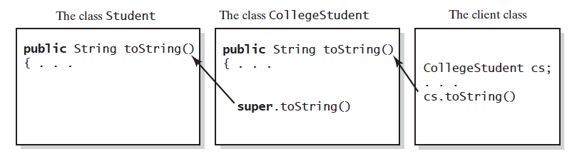
Overriding and
Overloading Methods
FIGURE D-4 The method toString in CollegeStudent overrides the method toString in Student
© 2015 Pearson Education, Inc., Upper Saddle River, NJ. All rights reserved

Slide 19
Overriding and
Overloading Methods
When subclass has a method with same name as a method in its superclass,
  but the methods’ parameters differ in number or data type …
Method in subclass overloads method of superclass.
  Java is able to distinguish between these methods
  Signatures of the methods are different
© 2015 Pearson Education, Inc., Upper Saddle River, NJ. All rights reserved

Slide 20
Overriding and
Overloading Methods
Possible to call an overridden method of the superclass by prefacing the method name with super and a dot.
But … repeated use of super is not allowed
© 2015 Pearson Education, Inc., Upper Saddle River, NJ. All rights reserved

Slide 21
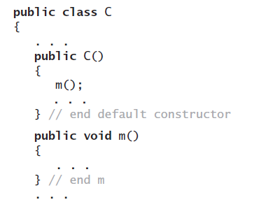

Overriding and
Overloading Methods
To specify that a method definition cannot be overridden with a new definition in a subclass
  Make it a final method by adding the final modifier to the method header.
© 2015 Pearson Education, Inc., Upper Saddle River, NJ. All rights reserved

Slide 22
Multiple Inheritance
Some programming languages allow one class to be derived from two different superclasses
  This feature not allowed in Java.
In Java, a subclass can have only one superclass
© 2015 Pearson Education, Inc., Upper Saddle River, NJ. All rights reserved

Slide 23
Type Compatibility and Superclasses
An object of a subclass has more than one data type.
Everything that works for objects of an ancestor class also works for objects of any descendant class.
© 2015 Pearson Education, Inc., Upper Saddle River, NJ. All rights reserved

Slide 24


Type Compatibility and Superclasses
Given CollegeStudent, subclass of Student
Legal calls
Illegal calls
© 2015 Pearson Education, Inc., Upper Saddle River, NJ. All rights reserved

Slide 25
The Class Object
Java has a class—named Object
  It is at the beginning of every chain of subclasses
  An ancestor of every other class
Class Object contains certain methods
  Examples: toString, equals, clone
  However, in most cases, you must override these methods
© 2015 Pearson Education, Inc., Upper Saddle River, NJ. All rights reserved

Slide 26
The Class Object
Inherited version of toString returns value based upon invoking object’s memory address.
Need to override the definition of toString
  Cause it to produce an appropriate string for data in the class being defined
© 2015 Pearson Education, Inc., Upper Saddle River, NJ. All rights reserved

Slide 27
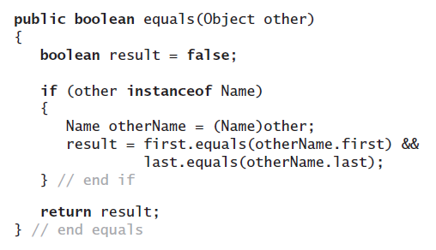
The Class Object
Object’s equals method compares the addresses of two objects
  Overridden method, when added to the class Name, detects
  whether two
  Name objects
  are equal by
  comparing their
  data fields:
© 2015 Pearson Education, Inc., Upper Saddle River, NJ. All rights reserved

Slide 28
The Class Object
Class Object method clone.
  Takes no arguments and returns a copy of the receiving object
We will need to override this method
Discussion of the method clone appears in Java Interlude 9.
© 2015 Pearson Education, Inc., Upper Saddle River, NJ. All rights reserved

Slide 29
Creating Classes from Other Classes
End
© 2015 Pearson Education, Inc., Upper Saddle River, NJ. All rights reserved

